Slide 1
4CM525 Functional Programming
Prof Stephan Reiff-Marganiec University of Derby
2024-2025

Slide 2
4CM525 Functional Programming Lecture 7 Higher Order Functions 2
Prof Stephan Reiff-Marganiec University of Derby
2024-2025

Slide 3
Today
Sorting Algorithms
Higher order functions in sorting

Slide 4
Sorting Algorithms
Sorting algorithms rearrange a list into an order
sort [2, 7, 13, 5, 0] = [0, 2, 5, 7, 13]
Usually recursive, by sorting a smaller list
Elements in the list need to be a of a type that has order on them
Obviously you can also sort on other structures, e.g. trees using the right functions

Slide 5
Insertsort
Idea: To sort the list, sort the tail recursively and then insert the head
Input: a list, output: a (sorted) list
insertsort :: [Int] –> [Int]
insertsort [] = []
insertsort (x:xs) = insert x (insertsort xs)
insert :: Int -> [Int] -> [Int]
insert n [] = [n]
insert n (x:xs) | n <= x = n:x:xs
| otherwise = x:(insert n xs)

Slide 6
Quicksort
Idea: pick an n in the list, sort the list of all numbers smaller than n ++ all the n’s ++ sort the list of numbers greater than n
Input: a list, output: a (sorted) list
quicksort :: [Int] –> [Int]
quicksort [] = []
quicksort (x:xs) = quicksort (less x xs)
++ occs x (x:xs)
++ quicksort (more x xs)
Ok, we now need three ‘helpers’: less, occs and more

Slide 7

Quicksort
less: given a number n and a list returns a list with all elements smaller than n
more: given a number n and a list returns a list with all elements larger than n
occs: given a number n and a list returns a list with all occurrences of n
How can we implement these?
Using filter!!
This Photo by Unknown Author is licensed under CC BY-NC

Slide 8
Quicksort
less: given a number n and a list returns a list with all elements smaller than n
less :: Int -> [Int] -> [Int]
less n xs = filter (\x -> x < n) xs
more: given a number n and a list returns a list with all elements larger than n
more :: Int -> [Int] -> [Int]
more n xs = filter (\x -> x > n) xs
occs: given a number n and a list returns a list with all occurrences of n
more :: Int -> [Int] -> [Int]
more n xs = filter (\x -> x == n) xs

Slide 9
Mergesort
Idea: split list in half, sort each half recursively and then merge together
Input: a list, output: a (sorted) list
We have seen this in an earlier lecture

Slide 10
Sorting revisited!
What did all the sorting algorithms have in common?
They worked on [Int] … what if I want to sort strings or characters?
No problem:
quicksort :: [Int] –> [Int] quicksort :: Ord a => [a] –> [a]
insertsort :: [Int] –> [Int] insertsort :: Ord a => [a] –> [a]
insert :: Int -> [Int] -> [Int] insert :: Ord a => a -> [a] -> [a]
let’s makes sure that the datatype has an order: they’ll be part of class Ord
They ordered lists in ascending order, how do we get sorting algorithms that order in other ways, say descending?

Slide 11
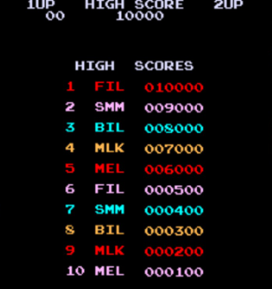
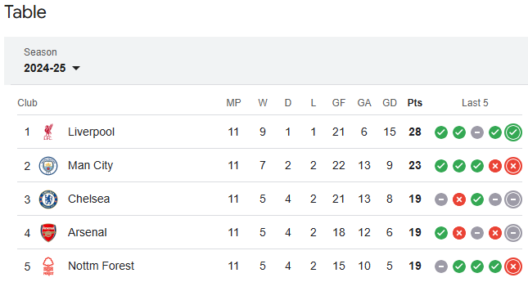
Games tables
Sports or Computer games: highest scoring player on top
Simple table is [(name/team, points)]
How do we sort this?
And how do we sort in different
way, say by player name?

Slide 12
The return of the Higher-order function!
Recall:
Definition: A higher-order function is a function that takes a function as input and/or returns a function as output
So, we need to parametrize the order function in our sort algorithms
Let’s fix the type signatures
quicksort :: Ord a => (a -> a -> Bool) -> [a] –> [a]
insertsort :: Ord a => (a -> a -> Bool) -> [a] –> [a]
Notes:
Look back at where the <, > etc was used …

Slide 13
Higher-order functions in sorting
Let’s look back where the comparisons were done
Quicksort: less, occs and more
less :: Ord a => (a -> a -> Bool) -> a -> [a] -> [a]
less ord n xs = filter (\x -> (ord n x)) xs
Insert Sort: insert
insert :: Ord a => (a -> a -> Bool) -> a -> [a] -> [a]
insert ord n [] = [n]
insert ord n (x:xs) | (ord n x) = n:x:xs
| otherwise = x:(insert n xs)

Slide 14
Leaves us to sort out ord
ord :: Ord a => a -> a -> Bool
A function that determines the order of two items
(<) or (>)
e.g. to get less as we had it before less (<) 5 [4,5,6,7,8,9]
Or you can define your own
e.g. order on pairs of (name, score) by score decreasing
lower :: (Ord a, Ord b) => (a, b) -> (a, b) -> Bool
lower (a1, b1) (a2, b2) = b1 < b2

Slide 15
This week we looked at higher-order functions We’ll look at more of this next week, but before you’ll try some in the lab.

